Slide 1
Parli pro: wig
Competitive events: trophy
Ethics/business skills: handshake
People: suit and tie
Historical dates and locations: US map
Principles and procedures: gavel

Slide 2


Slide 3


Slide 4


1st

Slide 5
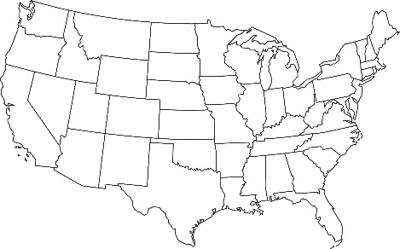

Slide 6


Slide 7



